Slide 1
User interface design
xkcd

Slide 2
UI Design: Wednesday Week 8
Dr. Jillian Aurisano
Plan for today:
Announcements/Course logistics
Usability review
Errors
Notes:
So welcome to engineering visual interfaces for data science. I'm Dr Aurisano.
Thanks for finding the class on Zoom. Hopefully we will be in person again soon.
If anyone out there is comfortable turning on their cameras, that is lovely- then I feel like I am talking to students, rather than to myself.
Here’s our plan for today:
First I’m going to introduce myself, so you know a bit about me
Then we are going to get to know each other, in Zoom breakout rooms. This will give us a chance to make sure that Zoom breakout rooms work, and we all know how to access them.
Then, I am going to walk through the structure, and plan for the course. I want to make sure everyone knows how the course will work, and what to expect, and also a bit about why the course is designed this way.
Then I am going to introduce the class, and what the class is about. Since this is a new class, and one of just a few classes in human centered computing here at UC, I wanted to give an overview of the topic.
Then I have an introductory activity, which we will do in breakout rooms, and which I think will help motivate the discussion on Wednesday, and getting into the meat of the class.

Slide 3
We discussed usability
Learnability
Efficiency
Safety (errors)

Slide 4
During taking an action, humans may make an error
Human error ≠ System error
What is the difference?

Slide 5
During taking an action, humans may make an error
Even if an interface is:
Easy to learn
Efficient to use in accomplishing your tasks
It may produce more errors than intended
Can anyone think of a UI that is easy to learn, efficient to use, but you make more errors than you intended?
“Safety” of a UI matters- how many errors it produces
What are the difference kinds of errors?
How can we work to reduce them?

Slide 6
During taking an action, humans may make an error
“Safety” of a UI matters- how many errors it produces
What are the difference kinds of errors?
How can we work to reduce them?

Slide 7
2 major types of human errors
Slips
Mistakes

Slide 8
Slip
A slip is an error of execution
You have the right goal for an action, you have the right plan
But you perform a different action without thinking
These errors happen unconsciously
Errors in doing

Slide 9
Examples of a Slip
Slips are often errors in behaviors you know how to do
Failure to correctly execute the procedure you know.
Example: You want to open a file. You know that this means you need to find it in the file system and double click it. You fail to correctly perform the double click action. The file doesn’t open.
You know how to do these tasks. If you make an error, it is probably a slip

Slide 10
Examples of a Slip
Slips are often errors in behaviors you know how to do.
Failure to correctly execute the procedure you know.
Example: You want to attach a file to an email. You know how to do it- you do it all the time. You forget to attach the file and send anyway.
You know how to do this task. If you make an error, it is probably a slip

Slide 11
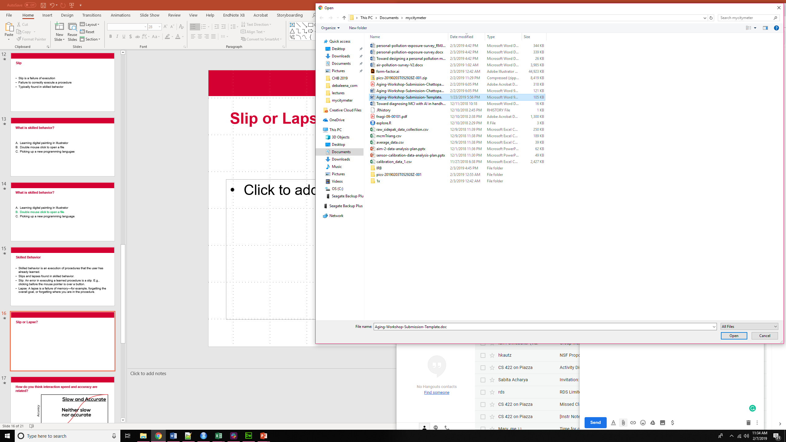
Slips
Clicking before the mouse pointer is over a button
Clicking on the wrong file when attaching file to email
Notes:
An error in execution of any learned procedure would be a slip.

Slide 12
Kinds of slips: Memory Lapse
Memory-lapse: a failure of memory—for example, forgetting the overall goal, or forgetting where you are in the procedure.
Forgetting to hit ‘send’ for an email, because you get distracted
Forgetting to attach a file to an email
Forgetting to renew a subscription to a software
Forgetting to save
You know how to do these actions, but you get distracted or are forgetful
Can we think of examples of UI design helping us avoid these kinds of memory lapses?

Slide 13
Kinds of slips: Action-based slips
“Blunders”
Clicking before your mouse is hovering over the target
Attaching the wrong file to the email
Dragging a file into the wrong directory

Slide 14
Action-based slips-Capture
A capture slip occurs when a person starts executing one sequence of actions, but then veers off into another (usually more familiar) sequence that happened to start the same way.
driving to school instead of to the dentist
if a user intends just to save the file (:w) but accidentally quits as well (:wq), then they’ve committed a capture error.
I go to the UI course rather than my new course, out of habit
A good mental picture for this is that you’ve developed a mental groove from executing the same sequence of actions repeatedly, and this groove tends to capture other sequences that start the same way.

Slide 15
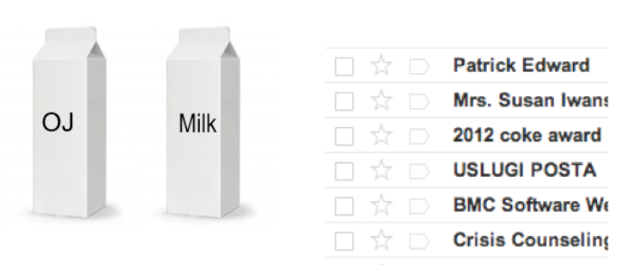
Action-based slips: Description slips
A description slip occurs when two actions are very similar (NOT the result of the actions).
The user intends to do one action, but accidentally substitutes the other.
Consistency (same) is good for learning
Inadvertent similarity (close but not quite) is bad for safety
Example-
dragging wrong file, because they look the same
pulling OJ out of fridge instead of milk
Notes:
A classic example of a description error is reaching into the refrigerator for a carton of milk, but instead picking up a carton of orange juice and pouring it into your cereal.

Slide 16
Action-based slips: Mode error
Modes are states in which the same action has different meanings.
Example:
Caps Lock mode is enabled on a keyboard, the letter keys produce uppercase letters.
The text editor vi is famous for its modes: in insert mode, letter keys are inserted into your text file, while in command mode (the default), the letter keys invoke editing commands.
Drawing tools have modes- shape creation, select+reposition, free draw
I have a remote that controls multiple TVs. Which TV is current?
Caused by failing to correctly evaluate the state of the interface.

Slide 17
Causes of slips
Inattention or inappropriate attention
omission or distraction of attention at a key moment.
strong-but-wrong behavior.
the particular erroneous be behavior (as in capture and description slips), or of its high frequency relative to the correct behavior (as in capture slips). Very common, or very similar, patterns are strongly behavior chosen is often selected because of its high similarity to the correct available for retrieval from human memory. (think elaborate rehearsal)

Slide 18
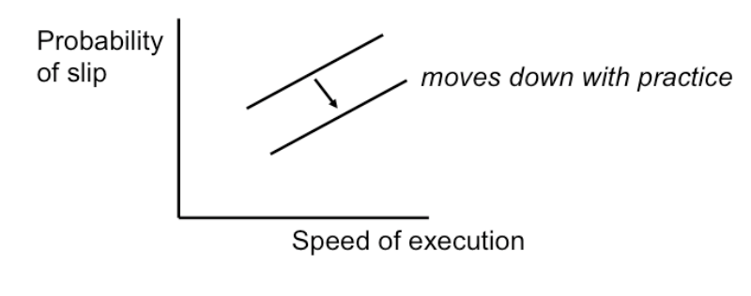
Causes of slips: Speed-accuracy trade-off
Trying to do something quickly- speed/accuracy trade-off. Practice helps, but doesn’t eliminate

Slide 19
Errors
Slips
Mistakes

Slide 20
Mistakes
Mistakes
Using wrong procedure for the goal
Arises from not understanding the system or rules
Having inaccurate or incomplete knowledge

Slide 21
Slip or mistake?
An instructor is using iClicker for the first time in class. She wants to find out which students have registered their iClickers. She clicks on Users and Groups → Users. iClicker registration is not shown.
Slip
B. Mistake

Slide 22
Slip or mistake?
An instructor is using iClicker for the first time in class. She wants to find out which students have registered their iClickers. She clicks on Users and Groups → Users. iClicker registration is not shown.
Slip
B. Mistake

Slide 23
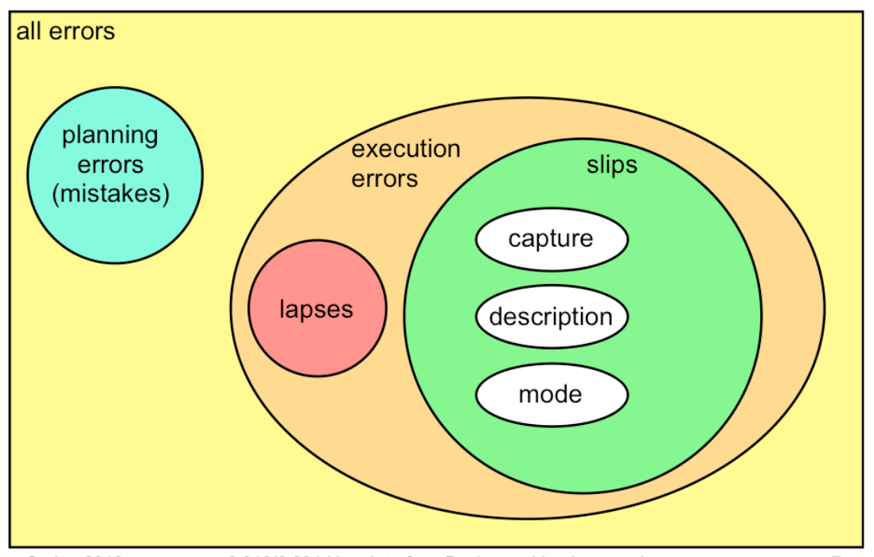
Overview
Slips are more common than mistakes, because we spend most of our actual time executing learned procedures.

Slide 24
How do we address this errors?

Slide 25
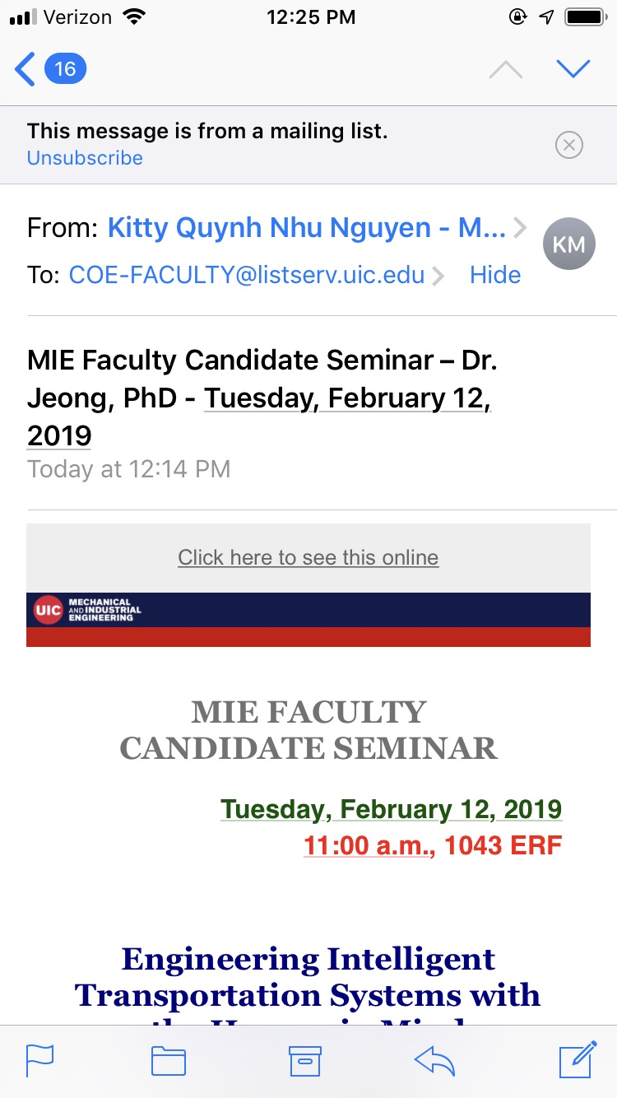
Error Prevention
Safety from Capture Errors
Avoid habitual action sequences with identical prefixes
Description errors can be fought off by applying the converse of the Consistency heuristic:
different things should look and act different,
so that it will be harder to make description errors between them.

Slide 26
Safety from Mode Errors
Eliminate modes
not always possible
Increase visibility of mode
mode status indicators must be visible in the user’s locus of attention.
when mode errors occur, the user isn’t actively looking for the mode
Spring-loaded or temporary modes
The Shift key is a spring-loaded version of the uppercase mode.
Drag-and-drop is another spring-loaded mode
Disjoint action sets in different modes
design action sets so that no two modes share any actions.

Slide 27
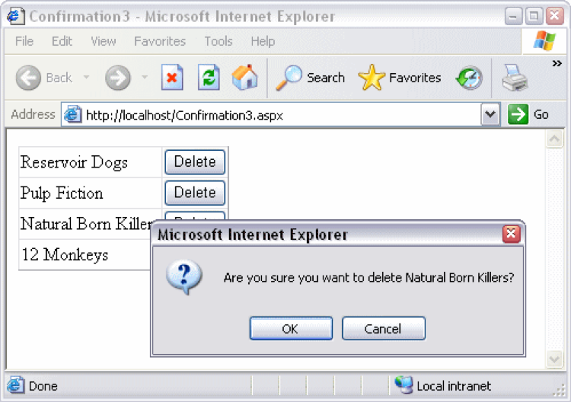
Confirmation dialogs
Confirmation dialogs can substantially reduce the efficiency of the interface.
May create habituation effect for expert users--only to slow down the interface without actually preventing any errors.
So, not ideal. But still useful
Consider reversibility (i.e., undo) is a far better solution than confirmation.

Slide 28
Error Messages
Best error message is none at all
Errors should be prevented
Be more flexible and tolerant
Nonsense entries can often be ignored without harm
Be precise and comprehensible
Suggest reasons and solutions
Be polite and non blaming
Avoid loaded words such as fatal, illegal, aborted, terminated
Try to eliminate the error first.

Slide 29
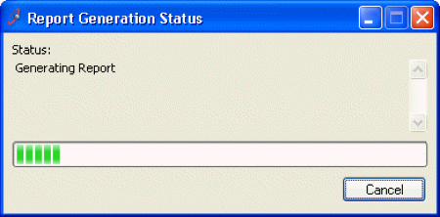
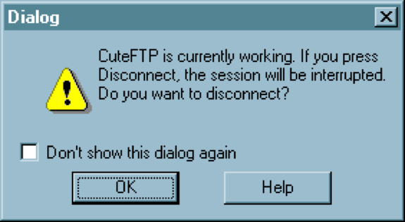
Clearly Marked Exits
Long operations should be cancelable
All dialogs should have a cancel button

Slide 30
Reversibility
Users will make errors
Can you make actions reversible
Some way to ‘undo’ an action
Or go back

Slide 31
Undo
If Cancel is the most common answer for user control over dialog, then Undo is the most common answer to user control over data.
The first Mac applications supported only single-level undo - that is, you could undo the last command, but no farther. This was largely due to memory constraints, and modern desktop applications allow unlimited undo (or so much that it makes no difference given the current interface for Undo - nobody is going to press Ctrl-Z 1000 times, after all).
But what can we do with smartphone apps? It’s mostly a do-over.

Slide 32
Forming a Mental Model of Undo
Undo reverses the effect of an action
But that leaves many questions:
What stream of actions will be undone?
How is the stream divided into undoable units?
Which actions are undoable, and which are skipped?
How much of the previous state is actually recovered by the undo?
How far back in the stream can you undo?
View vs. Model

Slide 33
What will be undone?
Actions in this window (MS Word) or entire app (MS Excel)
Actions in this text widget (Web browser)
Just my actions, or everybody’s? (multiuser apps)
Actions made by the computer
MS Office AutoCorrect and AutoFormat are undoable, even though the user didn’t do them

Slide 34
How is the stream divided into units
Lexical Level
Mouse clicks, key presses, mouse moves
Nobody does it at this level
Syntactic level
Commands and button presses
Semantic level
Changes to application data structures (e.g. the result of an entire Format dialog)
This is the normal level
Text entry is aggregated into a single action
But other editing commands (like Backspace) and newlines interrupt the aggregation
What about user-defined macros?
Undo macro actions individually, or as a unit?

Slide 35
Which actions are undoable?
User’s action stream may include many actions that are ignored by Undo
Selection
Keyboard focus
Changing viewpoint (scrolling, zooming)
Changing layout (opening palettes or sidebars, adjusting window sizes)
UI customization (adding buttons to toolbars)
So which actions does Undo actually undo?
Some applications (web browsers, IDEs) have Undo/Redo for the editing stream, Back/Forward for the viewport stream

Slide 36
How much state is recovered?
Even if the Undo stream doesn’t include all the view changes you make, how much of the view state will be restored when it reverses a model change?
When you undo a text edit, for example, will the selection highlight be restored as well?
Will the text cursor be put back where it was before the edit?
If the text scrolls, will it be scrolled back to the same place?

Slide 37
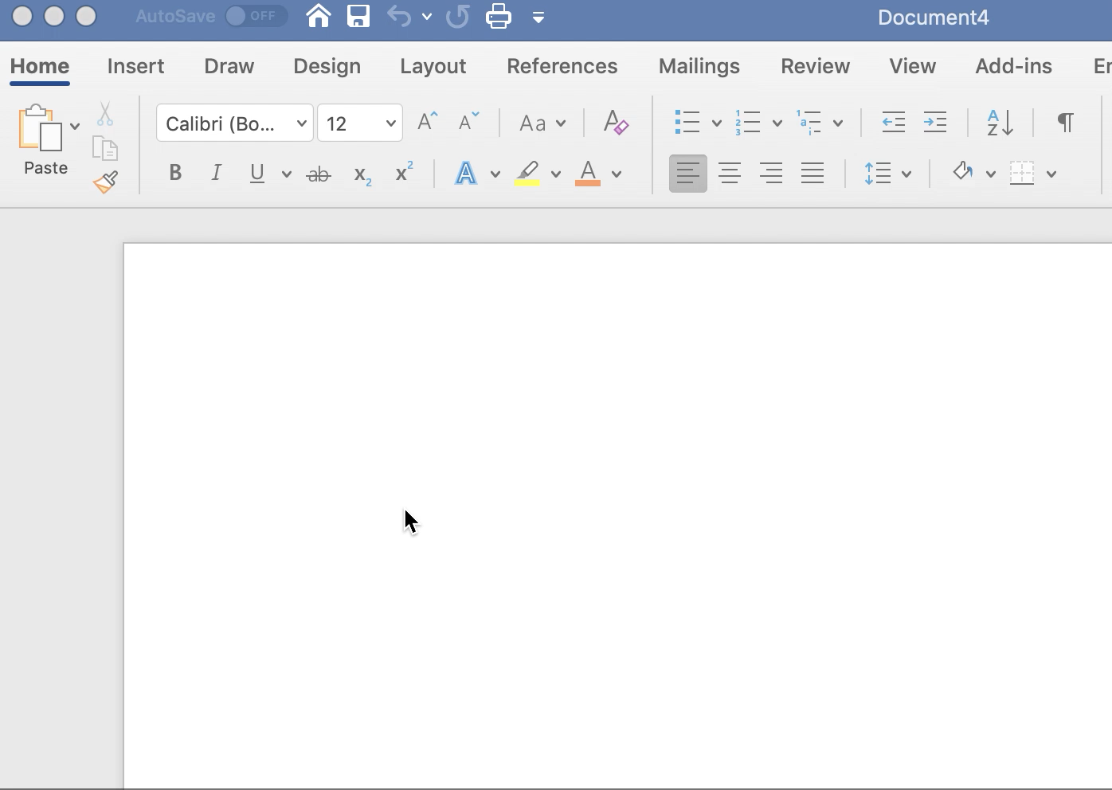
How much state is recovered?

Slide 38
How far back can you undo?
Often a limit on history size
Used to be one action - now usually hundreds, or infinite!
Does action stream persist across application sessions? Different files of the same application?
If so, stream must be saved to file
Microsoft Excel, despite being part of the same office suite, has a global action stream. Invoking Undo undoes actions from across all open Excel windows.
Does it persist across File/Save?

Slide 39
Design Principles for Undo
Visibility
Aggregation
Reversibility of the Undo itself
Reserve it for model changes, not view changes
Undo is not the only way to support reversibility

Slide 40
Design Principles for Undo: Visibility
It’s very hard for users to predict what Undo will do.
Faced with this unpredictability, a common strategy is to press Undo until you see the effect you want to reverse actually go away, or until you realize it’s gone too far without solving the problem (i.e., it’s reversed an older, still-desired effect).
So visibility of Undo’s effects is a critical part of making it usable. Whenever Undo undoes a command, it should make sure that the effects of that have a visible change on the screen.
If the user has changed the viewpoint (e.g. scrolling) since doing the command that is now being undone, the viewpoint should be changed back, so that it’s easy to see what was reversed.

Slide 41
Design Principles for Undo
Aggregation
The unit actions should correspond to chunks of the user’s interaction: whole typed words (or strings), complete dialogs, user-defined macros.
Reversibility of the Undo itself
Undo itself should be reversible, so that if you overshoot, you can come back.
That’s what the Redo command is for.
Another way to reverse an Undo is to manually issue the undone command again; a good undo mechanism should set up the conditions for this as well

Slide 42
Design Principles for Undo
Reserve it for model changes, not view changes
For consistency, reserve the Undo command for model changes.
You can use other commands for view changes.

Slide 43
Undo is not the only way to support reversibility
Keep in mind that you don’t necessarily need a command named “Undo” to support reversibility.
There are other commands that move through other action streams (Back), and physical manipulations (like scrollbar dragging) support direct reversibility.
Users may not even think of reaching for Undo if the rest of your interface makes it easy to reverse undesired changes.
Undo is a form of backward error recovery. It fixes errors by going back in time.
A more natural way of thinking is forward error recovery - using other commands to reverse the change.
For example, to undo a Bold command by forward error recovery, you select the text again and toggle Bold off.
If your interface supports forward error recovery as much as possible, then warts in the Undo model won’t hurt as much.

Slide 44
User Control and Freedom
Good interfaces are explorable.
Recall that a major way users learn is by doing: poking around an interface, trying things out.
An interface should encourage this kind of exploration, not only by making things more visible, but also by making the consequences of errors less severe.
Users should be able to explore the interface without fear of being trapped in a corner.

Slide 45
Wizard vs. Center Stage: Who’s in Control?
The wizard design pattern is a familiar pattern for improving the learnability of a complex interaction, by structuring it as a step-by-step process, showing each step in a dialog box.
Wizards are the conventional pattern for software installation.
In a wizard, the system controls the dialog - it dictates the steps, the ordering of the steps, and what it asks for at each step.

Slide 46
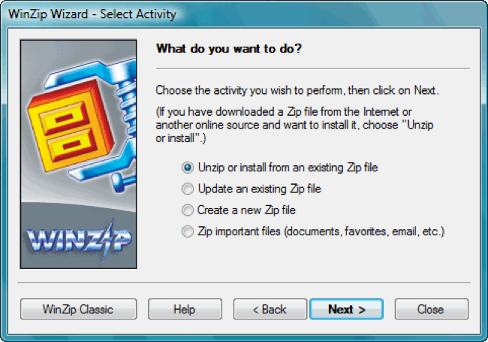

Slide 47
Wizard vs. Center Stage: Who’s in Control?
Contrast that with the center stage pattern, which lays out data objects in the main section of the window, and gives the user a set of tools for operating on the objects.
In this case, the user controls the dialog, deciding which objects to select and which tools to pick up.

Slide 48
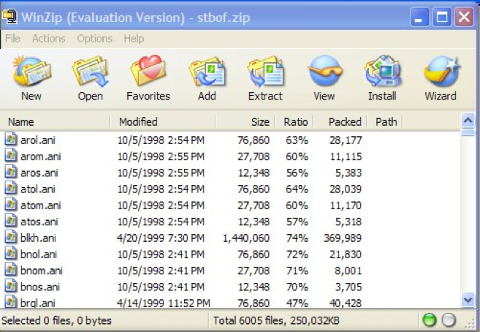

Slide 49
Wizard vs. Center Stage: Who’s in Control?
Wizards clearly restrict the user’s freedom, but for complex, infrequently-done tasks (like installation), the tradeoff is often worth it.
Note, however, that a good wizard has two key features: a Back button (for backing out of errors) and a Cancel button (for vetoing the operation entirely).
So even though the wizard pattern puts the system in control of the details, the user still has supervisory control.

Slide 50
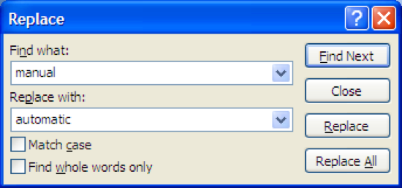
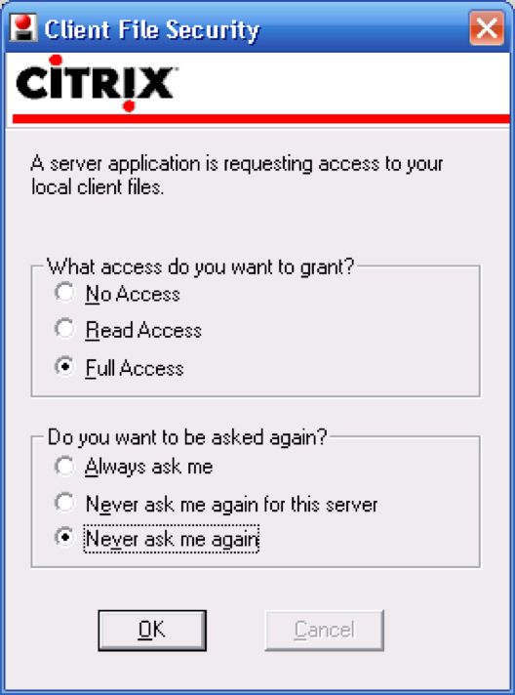
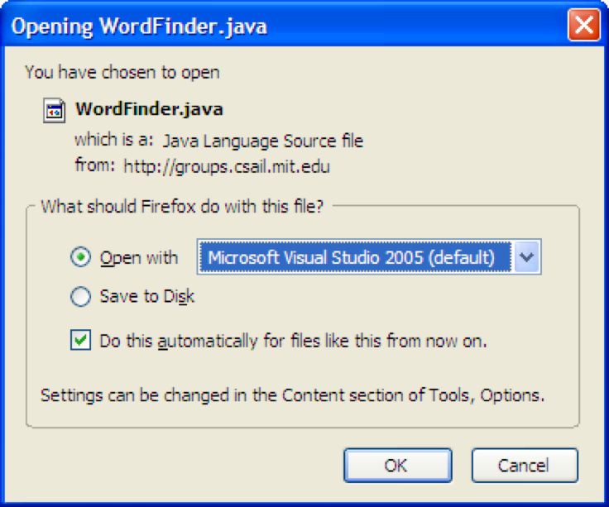
Other ways to provide user control
Manual Overrides for Automatic Systems
Never Ask Me Again
Default app

Slide 51
Users will make errors- think about how to prevent them
In your project group – make a list of potential errors your users might make
How could you limit these errors or prevent them?

